Slide 1
Clarification Question Generation: Technical Challenges and Practical Concerns
Zhiling Zhang

Slide 2


Traditional QG (SQuAD 1.1)
Given context and answer
Generate question

Slide 3
CQGen (StackExchange)
Clarification question: questions asking for information not in context
CQGen: Given context, generate CQs
answers are provided by the user being asked
Notes:
We can see that CQs can be used to interact with users to achieve certain goals, depend on the task
Learning to Ask Good Questions: Ranking Clarification Questions using Neural Expected Value of Perfect Information

Slide 4
Comparison
Traditional QG
CQGen
Traditional QG got the answer and its position as features
The novelty of most existing works comes from the use of them
CQGen doesn’t get the answer, but can predict the aspect of the answer (what the answer is about)
Notes:
This point is not explicitly stated in previous works, but I myself concluded that this is actually the key of most existing works of CQGen. I will give a brief review later.

Slide 5
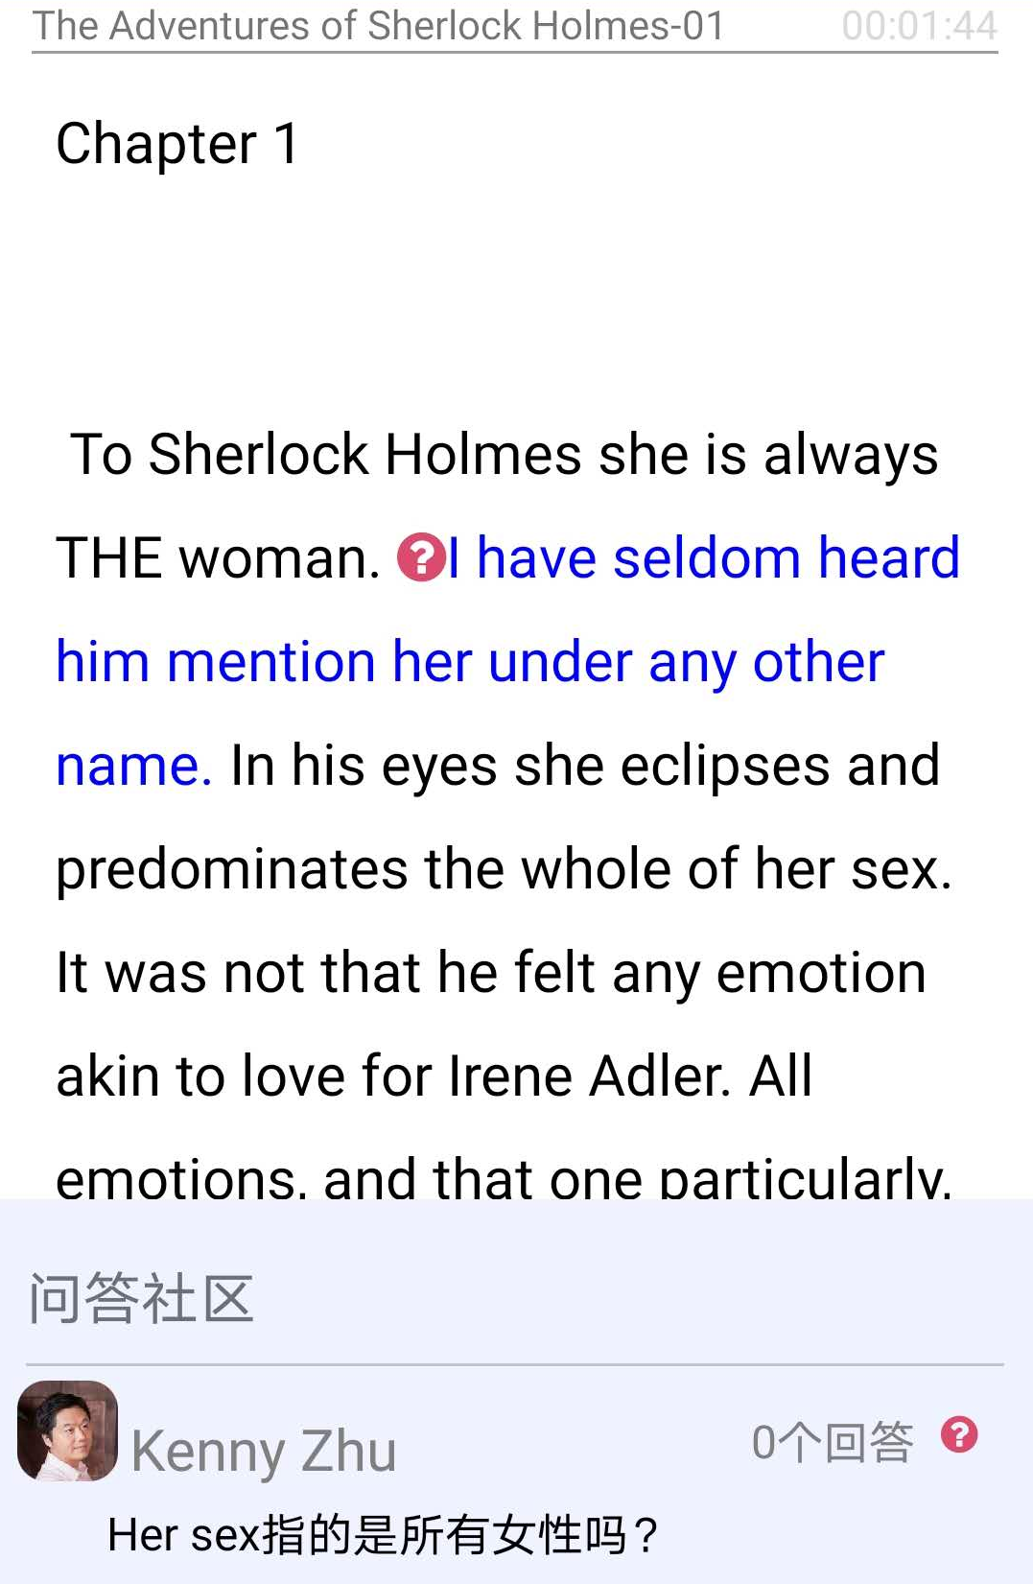
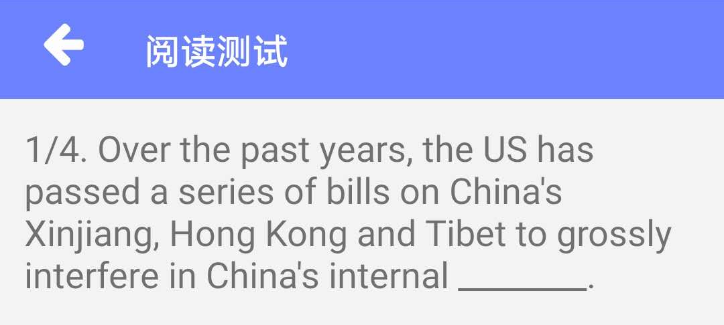
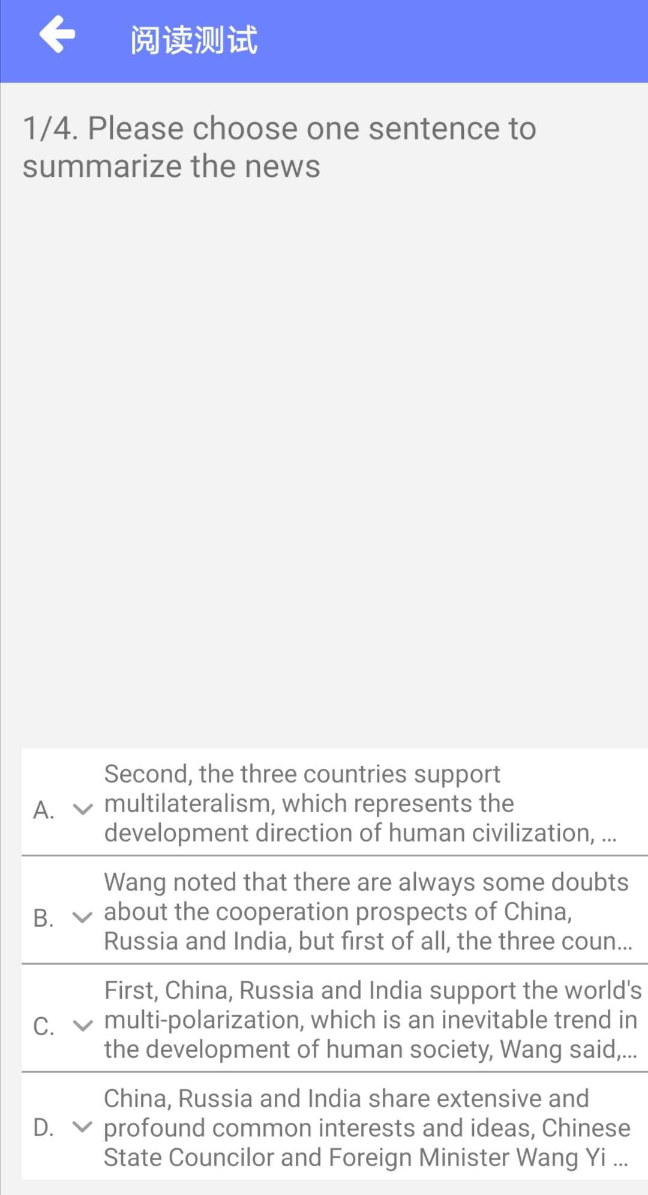
Quiz (Q or CQ?)
Q
Q
CQ
Notes:
Here is a quiz to test your understanding of the concept
I think this question is raised under some reasoning, because literally “her sex” just mean female, but we can know from the plot that Sherlock Holmes usually seems to pay no to any women. So her sex means all women here, although it is not explicitly stated in context.
CQs can be more open and involves more thoughts, thus more difficult to generate

Slide 6
Challenges of CQGen
Technical challenges
CQs must avoid asking for repetitive information (somewhat creative)
Most current generation models are good at “copying” tasks like translation and summarization, but not good at creation
CQs should be specific to be useful
Traditional QG are easier to get specificity from provided answer
E.g. Answer can limit the question type: person -> who, number -> how much
Application concerns
For certain task, there might be more effective and efficient alternatives
CQGen must prove its advantage over them to get into practice
Notes:
In contrast Traditional QG. …, But CQGen doesn’t have this clue, so it’s much harder to produce specific questions
If on some specific tasks, CQGen is unlikely to have an edge over alternatives, then we should avoid wasting times on CQGen for these tasks.
Then I ‘ll introduce several domains where CQGen can be used.

Slide 7
Post Refinement (StackExchange)
Usage
Refine the post and supplement necessary details to be get answered, according to the CQs
Notes:
Learning to Ask Good Questions: Ranking Clarification Questions using Neural Expected Value of Perfect Information

Slide 8
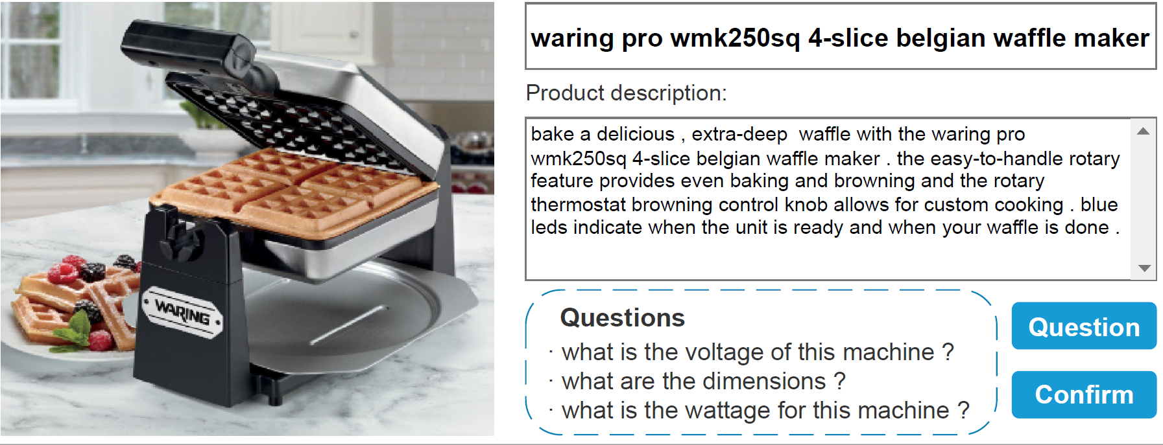
Post Refinement (Amazon)
Usage
Refine the product description, provide information that customer concerns, to get sold, according to the CQs
Notes:
This is my bachelor’s thesis. The domain is different, but the task is virtually the same.

Slide 9
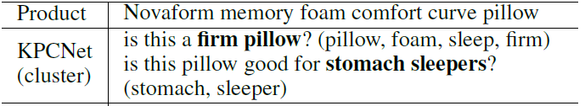
Method: KPCNet
Aspect of answer: Keywords
Nouns, verbs and adjectives in question, that are not stop words
Usually the attributes, parts or related items of the product
Can cover the main semantic of the question, and promote specificity
Approach:
Predict the keywords first
Generate CQs with predicted keywords as condition
Notes:
I said the aspect of answer is the key to CQGen. And here, my proposed model is a concrete example. The aspect of answer I used is keyword.
Based on this, the rough idea of my model is XXX.

Slide 10
Quiz
Product: Dining chair, blue grey, set of 2
Questions:
what is the color of the chair ?
what are the dimensions of the seat ?
what is the weight limit ?
What are the keywords of these questions? (n./v./adj.)
Color, chair, dimension, seat, weight, limit
Which question(s) are valid CQs? Which are not?
Q1 is not a valid CQ, because color has already been mentioned (blue grey)

Slide 11
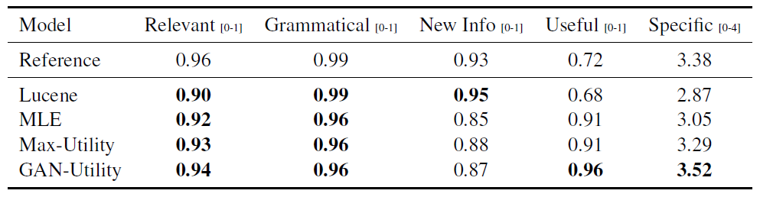
Alternative: retrieval (Lucene)
CQGen wins
With the content of the post, retrieve the CQs of similar posts
Human evaluation for a prior work (GAN-Utility)
The difference between the bold and the non-bold numbers is statistically significant with p <0.05. Reference is excluded in the significance calculation.
Retrieval method (Lucene) performs relatively poor in relevance, specificity and usefulness
Notes:
We have an alternative for CQGen in post refinement. That is, we retrieve CQs from existing similar posts.
Which one is better, let’s see a human evaluation comparison
We can see that …, And here the useful is measured by how many users may benefit from the generated questions.
To conclude, CQGen is currently better than the alternative, on this task
Answer-based Adversarial Training for Generating Clarification Questions

Slide 12
Information retrieval
Usage
Resolve the ambiguity of information need in short search queries
Notes:
For example, here the search query is a single word “headaches”, which is too short to figure out the true information need lying behind. And with this CQ, we can see that specific aspects are listed, and the user can select the one he truly cares, and get relevant results.

Slide 13
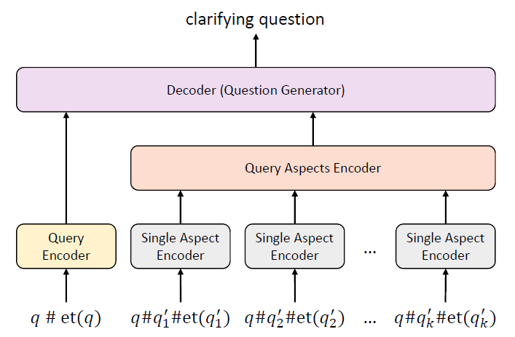
Method
Aspect of answer:
Directly harvested from search reformulation logs
Headache -> symptom
Approach
Use templates to make training CQs
What do you want to know about [Headache]? symptom
Feed the query and aspects to seq2seq model
Notes:
NCF: neural collaborative filtering [using user-word matrix, just like e-commerce website recommend similar products. The matrix is sparse so we need to predict]
templates
(1) What do you want to know about QUERY?
(2) What do you want to know about this QUERY_ENTITY_TYPE?
(3) What ASPECT_ENTITY_TYPE are you looking for?
(4) Whom are you looking for?
(5) Who are you shopping for?
I will skip details like NCF
Generating Clarifying Questions for Information Retrieval

Slide 14
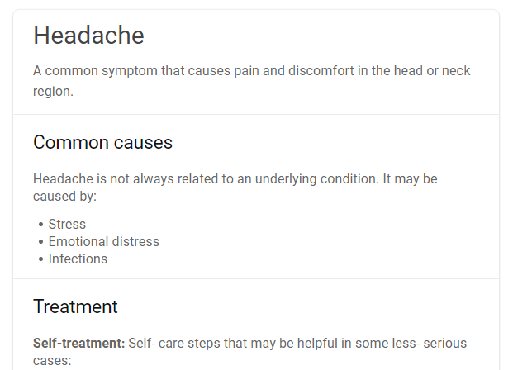

Alternatives
Query suggestion
Entity Card
The clarification panel was among the most favorite features in all search engine features including the above ones.
CQs have functional benefits and emotional benefits
CQGen wins
Notes:
There are 2 alternatives that we are already familiar with. They can also cover many possible aspects of the query. So how are they compared with CQs?
They did a user study. And the result is XXX.
Functional: questions help guide users in the right direction and to the right conclusion
Emotional
it brings to users a sense of confidence that the search engine understands what the user wants. Moreover, it gives the users a sense of security and coming to the
right conclusion. They pointed out that sometimes, especially when it comes to product search, they feel less stress when the search engine asks questions on different features of the product. Because without it, they often feel they forgot to check all necessary properties of the product.

Slide 15
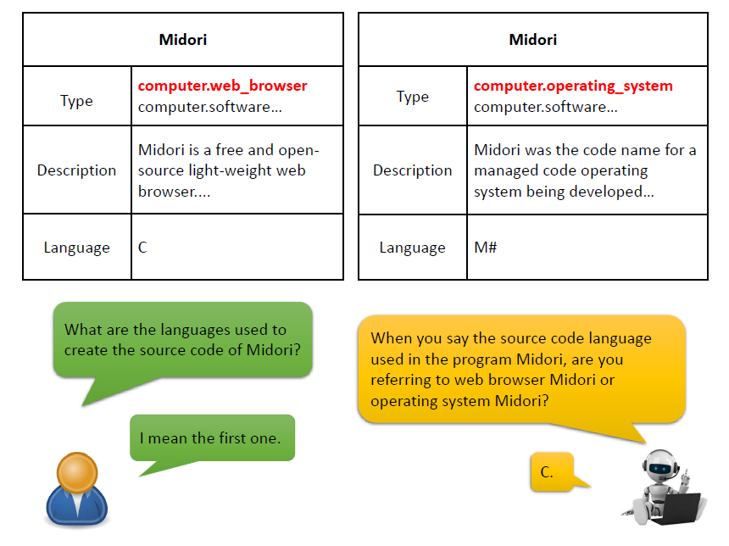
KBQA
Usage
Resolve the ambiguity in question entity so that a question can be precisely answered
Notes:
The user is asking XXX. And we found that there are 2 Midori, one is XX, another is XX.
So if you are the answer bot, how will you ask a CQ to resolve the ambiguity? This is a quiz
Asking Clarification Questions in Knowledge-Based Question Answering

Slide 16
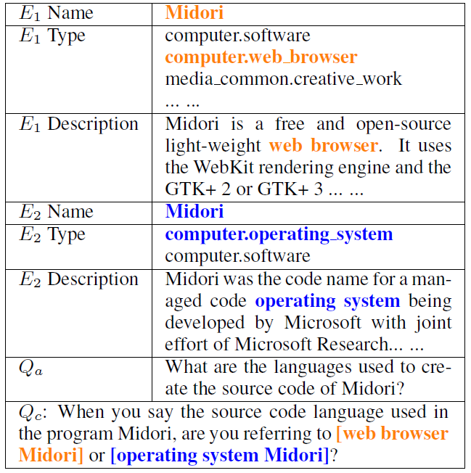
Method
Aspect of answer:
distinctive features of the entities
Approach
Feed the knowledge about the 2 entities to an seq2seq model and generate the distinctive descriptions of the 2 entities
A: web browser X, B: operating system X
Generate a template and fill in
When you say the source code language used in the program Midori, are you referring to [A] or [B]?
Notes:
I will skip the multi-turn case and other details like clarification identification

Slide 17
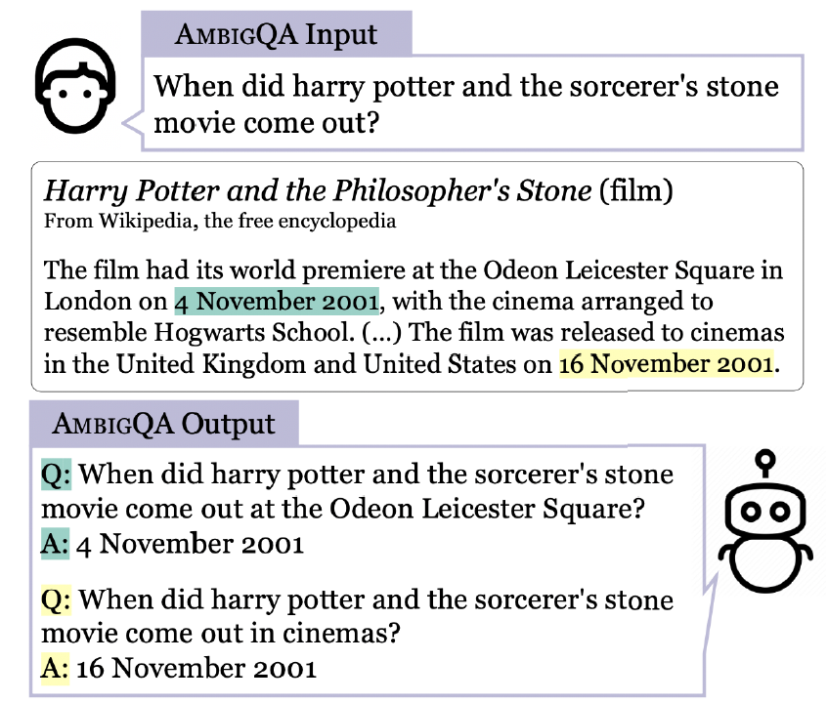
Alternative: AmbigQA
Can CQGen win?
Usage
Resolve the ambiguity in question so that a question can be precisely answered
Alternative approach
Directly rewrite the question to eliminate the ambiguity
Method
Predict answer from evidence text
Generate unambiguous questions with respective answer
Notes:
Since both approaches rely on generation model, they are similar in difficulty, so I myself can not say which one is better
AMBIGQA：Answering Ambiguous Open-domain Questions

Slide 18
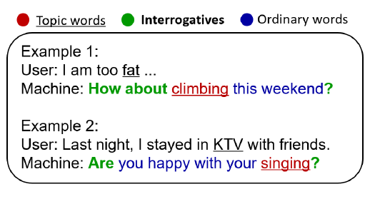
Dialog (chit-chat)
Usage
Make the chit-chat longer and more open with questions
Notes:
Generally, if we ask questions, we can make the chat longer …
Let’s see the example …
Learning to Ask Questions in Open-domain Conversational Systems with Typed Decoders

Slide 19
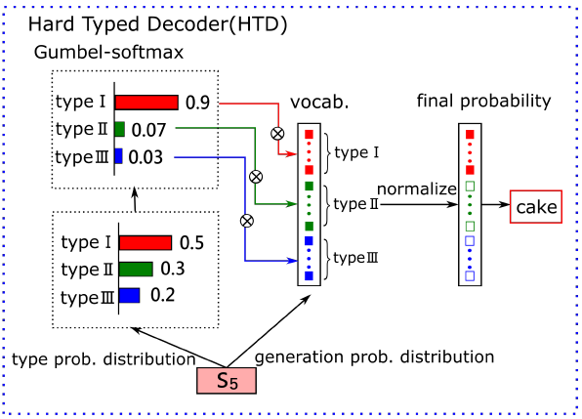
Method: typed decoder
Aspect of answer: 3 type of words
Topic words: nouns and verbs in question [answer topic]
Interrogatives: question words/phrases [answer type]
Ordinary words: other words
Approach: predict type first, then generate from the vocab of the type
Notes:
The author divide the words in question into 3 types.
The approach is XX, as the picture shows. I won’t explain the details
My work actually draws inspiration from it. But my model have a different design, which further improves the quality and allows for controllability.
Topic words are pre-predicted with PMI, which performs poorly on the Amazon dataset. This might only be useful in free chit-chat which has low requirement for precision

Slide 20
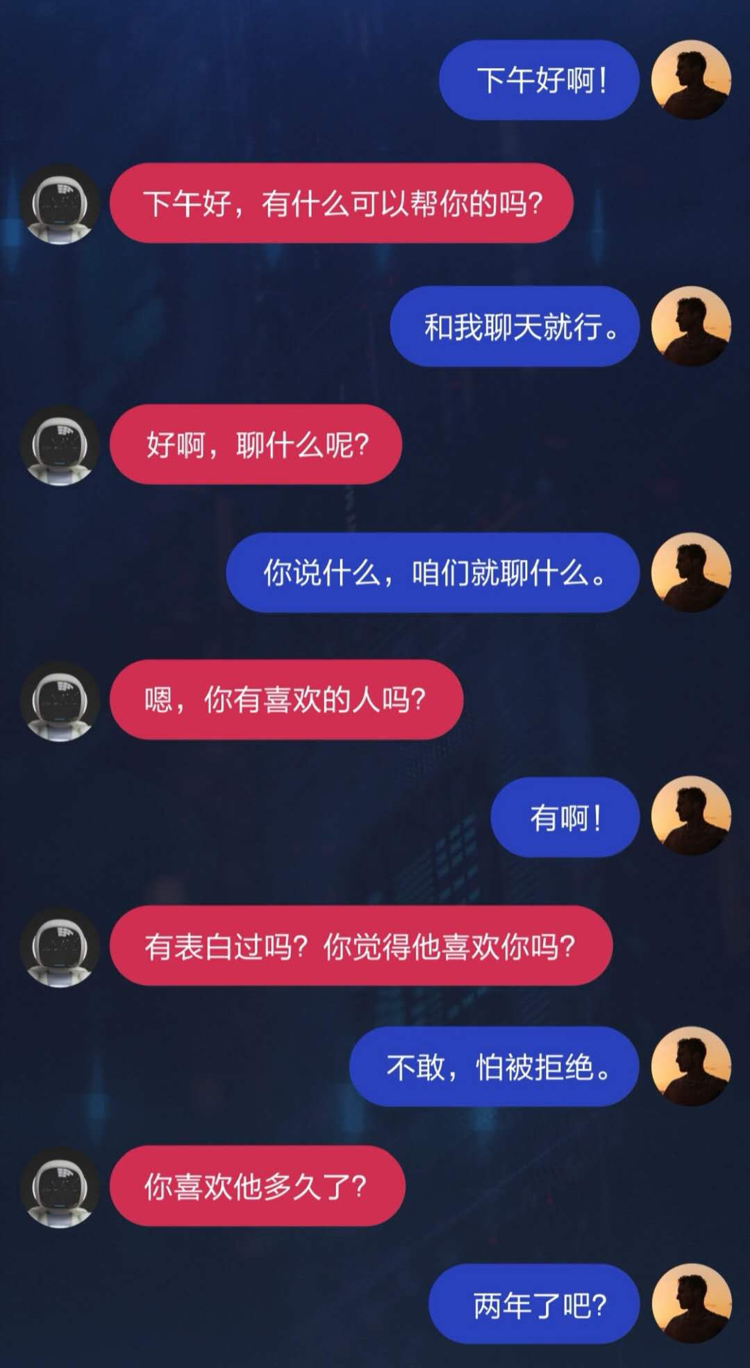
Alternative
Usage
Make the chit-chat longer and more open with questions
CQ approach
Design a specific CQGen module
Apply in a pipeline system which decides when to ask CQ
Alternative
End2End model
No need to design specific module, model generate CQ in black box
Example: Baidu Plato-2
Notes:
Since CQ is only part of a dialogue, it can only be a component of a system. The system must have a pipeline to decide when to ask CQ
This pipeline system would be a little bit complicated, an end2end model may be a more natural and simple alternative.
End2end model just generate some text, and it can be a CQ, and it can also be not. Then we don’t need to artificially design a specific module for CQGen.
I think Baidu’s PLATO-2 is now the SOTA of end2end chatbot (And I know Kenny just shared a Microsoft’s work for task-oriented Dialog system). If it is real and consistent, I think it’s quite well.
PLATO-2：Towards Building an Open-Domain Chatbot via Curriculum Learning

Slide 21
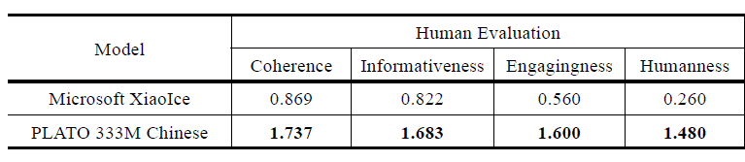
Alternative comparison
CQGen not promising
Representative pipeline-based system: XiaoIce, fell far behind the large end2end model PLATO-2
Pipeline system might suffer from error propagation
Intent classification, dialog state management (including the decision to make CQ), individual generation module, etc.
Training data of each stage needs to be artificially created
End2End model can directly learn from abundant natural texts
Notes:
Which one is better?
There is a comparison between PLATO-2 and a Representative pipeline-based system: XiaoIce. And we can see it is …
The possible reason is xxx
Since CQGen heavily relies on pipeline system, I think CQGen as a specific module for dialog is a not very promising direction

Slide 22
Conclusion
CQGen recently attracted many research interests and can be applied in a wide range of tasks
CQGen faces unique technical challenges including repetition and specificity, without the guidance of answer like in traditional QG
Many contributions on CQGen revolves around the aspect of answer
The difficulty of CQGen raises concerns over its practical usage, as there are competitive alternatives
From my opinion, CQGen has advantage in some tasks, but may also be not promising in other tasks

Slide 23

Conclusion
Task | Alternative | CQGen advantage
Post Refinement | Retrieval
Information retrieval | Query suggestion, Entity card
(Interactive) QA | AmbigQA
Chit-Chat bot | End2End model
Task-oriented dialog system | Rules and templates
Provoke thoughts in reading | ?
…… | …… | ……
?
×
?
?
Notes:
These are the tasks I’ve talked about.
Due to time limit, I haven’t mention several other works.
And I myself is also considering to work on question generation for provoking thoughts in book reading, which is a new task.
Hope I will do a good job.
That’s all.
That’s all for today, thanks.

